Slide 1
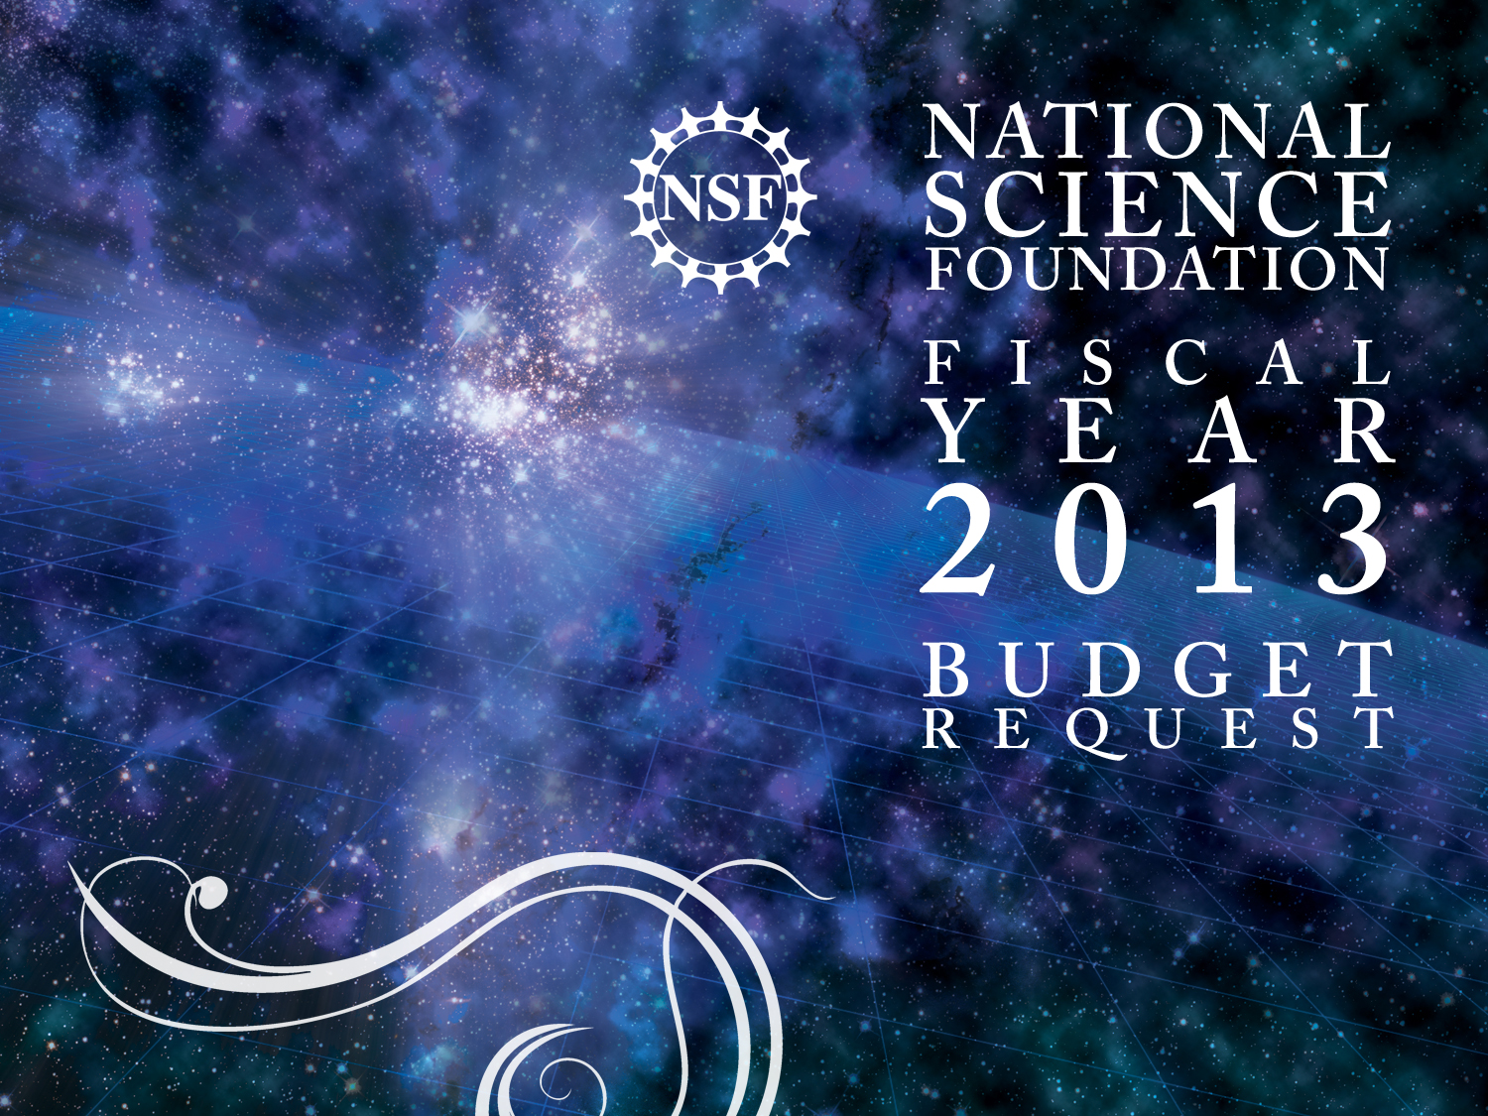
ENABLING RESEARCH, TRAINING, INFRASTRUCTURE, AND ADVANCED DESIGN AND DEVELOPMENT OF NATIONAL RESEARCH OBSERVATORIES
Elizabeth R. Blood
NEON and Macrosystems
Emerging Frontiers
BIO/NSF

Slide 2
Read the NSF Budget Request BIO FY 2013 Budget Request
TOTAL, BIO R&RA: $733.86 million, +3.0%
Research: $552 million
Learning: $30 million
Infrastructure: $141 million
Administration: $11 million
NEON Construction: $91 Million

Slide 3
BIO Issues, Opportunities, and Future Challenges
BIO Branding and Innovation
The Five Grand Challenges
Reforming undergrad biology education and STEM pipeline
Big Data, Advanced Cyberinfrastructure (ACI) to enable 21st Century Biology.
Broadening Participation
Public Outreach: Biology’s relevance to people’s lives

Slide 4
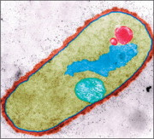
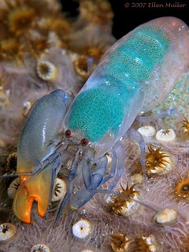
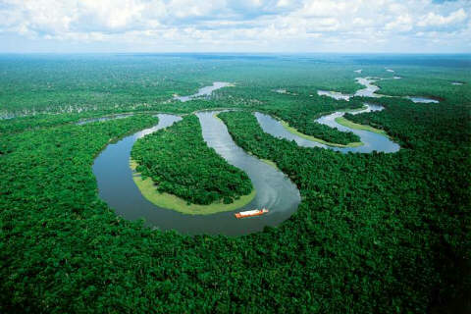
Grand Challenges for 21st Century Biology
Genomes to Phenomes
Synthesizing Life
Neurosystems
BIO CORE PROGRAMS
Earth, Climate,
& Biosphere
Biological Diversity
All BIO Core Programs
+ $20 million

Slide 5
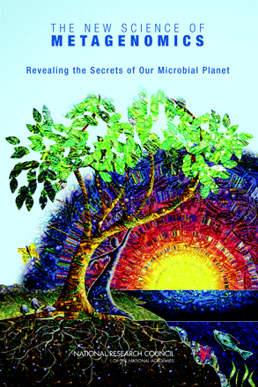
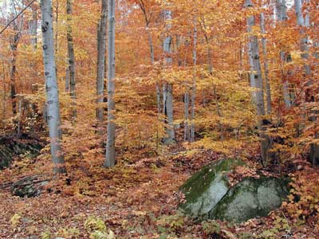
Genomes to Phenomes
Links genomes to ecosystems to understand the history of our planet and identify possible sustainable futures
Community DNA
Ecophysiology
Ecosystem Metabolism
© Michael J. Slezak
EVOLVING
GENOMES
EVOLVING
POPULATIONS
CHANGING
ECOSYSTEMS
5 Grand Challenges
Notes:
5
5
Ultimately, understanding the phenomena that link genes to ecosystems will help us understand the history of our planet, but also its likely future. A central challenge is now to understand how the global metabolic network evolved, and what the feedbacks are that generated the gas composition of the planetary atmosphere. To do this will require the urgent development of a global systems geobiology. They define this as the study of geochemistry and geophysics integrating with genomics, ecophysiology, and math in order to understand the processes and feedbacks that influence Earth’s overall metabolism. The overall goal is to be able to predict responses of the Earth’s systems to further external and internal perturbations.

Slide 6
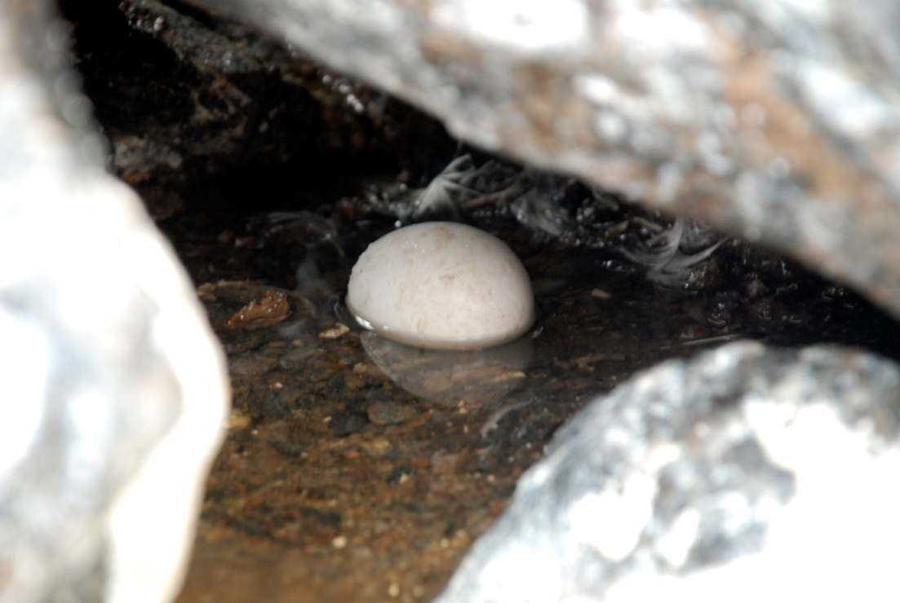
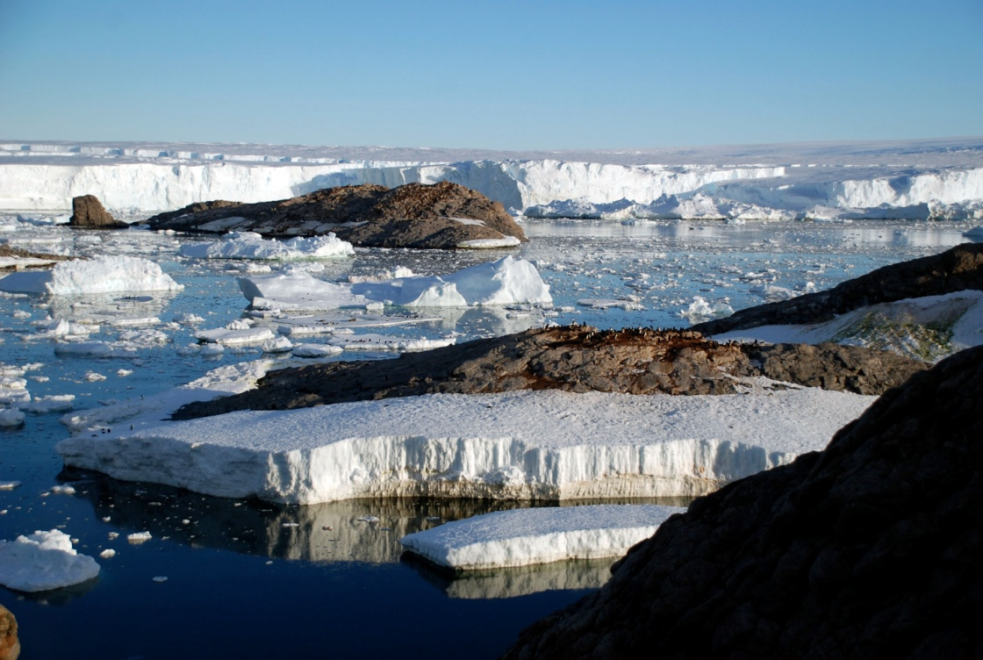
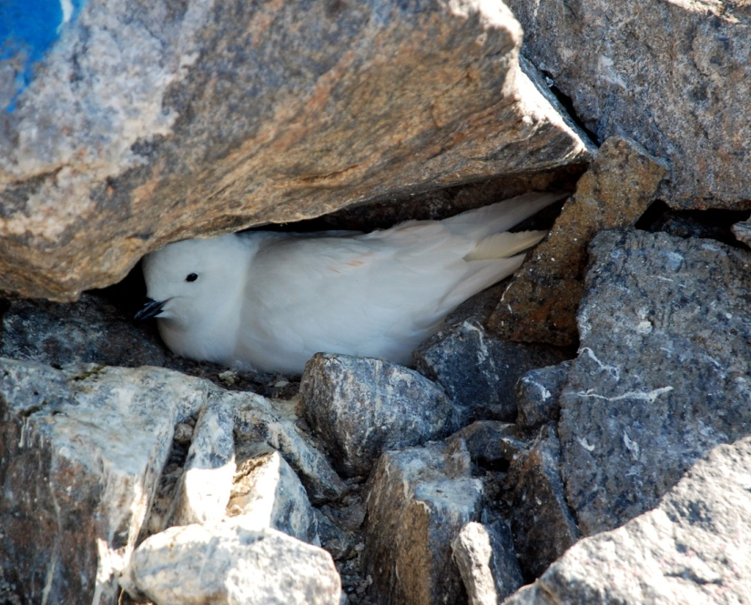
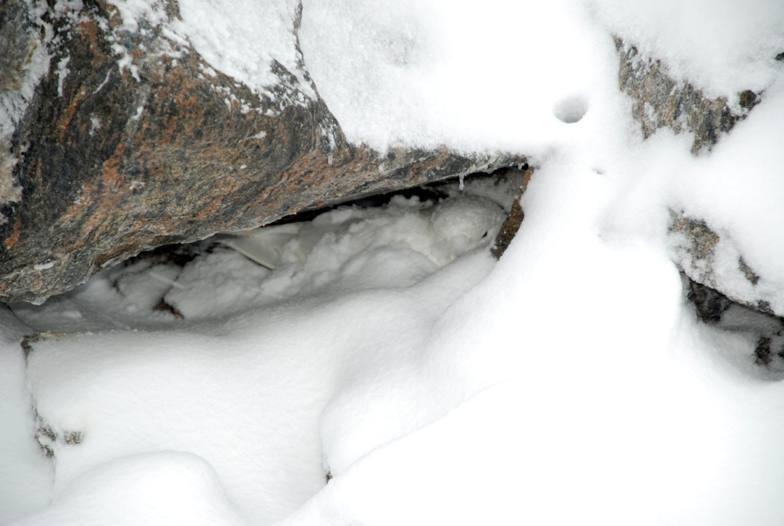
Organism - Environment Interactions
in a Changing World
Understanding species adaptation or extinction requires elucidating mechanisms that regulate morphology, physiology, and behavior in anticipation of predictable events such as day/night cycles, and rapid facultative changes that occur during and after unpredictable events
such as severe storms or climate change.
Antarctic snow petrel
5 Grand Challenges
Notes:
NSF supported research furthers our understanding of how life has both adapted to and transformed a changing plant
How will the biosphere respond to natural and human-induced changes across a range of time and space scales? What is the pace and pattern of the responses? What is the effect on ecosystem services, such as the availability of freshwater, across regions and continents?
The MacroSystems Biology: Research on Biological Systems at Regional to Continental Scales will support quantitative, interdisciplinary, systems-oriented research on biosphere processes and their complex interactions with climate, land use, and invasive species at regional to continental scales as well as planning, training, and development activities to enable groups to conduct MacroSystems Biology Research.

Slide 7
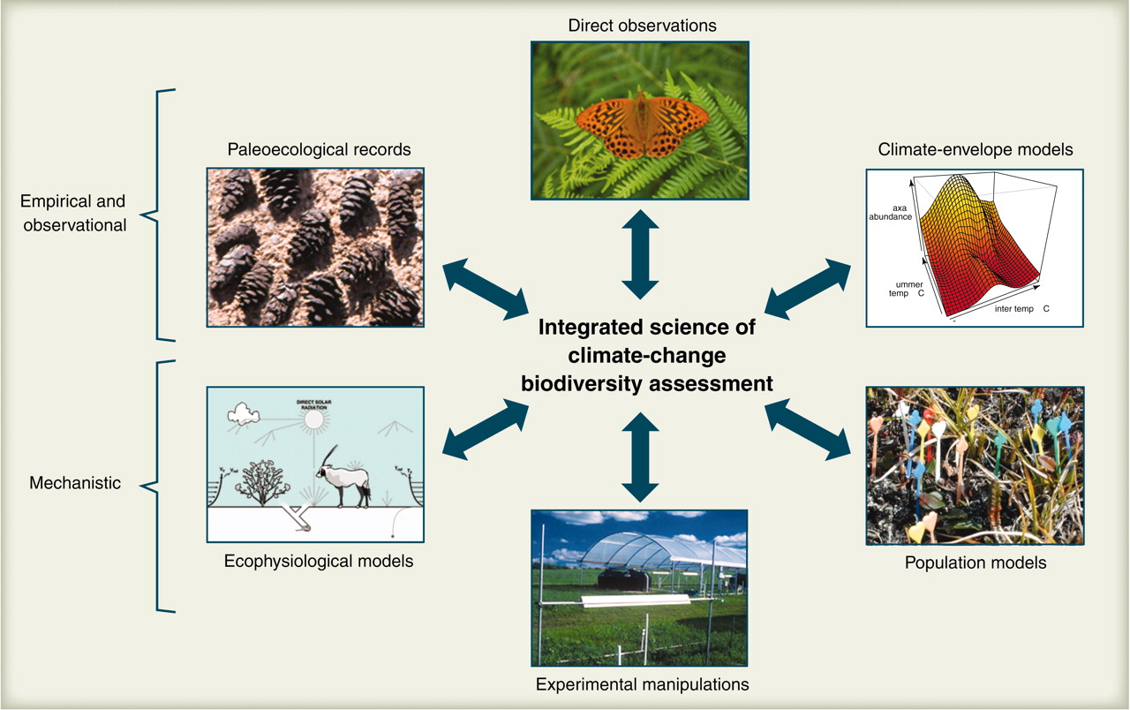
BIODIVERSITY
Understanding biodiversity requires an integrated science of climate and biodiversity assessment that uses multiple sources and approaches.
T P Dawson et al. Science 2011;332:53-58
Published by AAAS
5 Grand Challenges
Notes:
An integrated science of climate-change biodiversity assessment will draw from multiple sources and approaches. Each provides useful but incomplete information on exposure, sensitivity, and adaptive capacity. Integration of these approaches will provide a more robust basis for vulnerability assessment and allocation of resources for conservation and adaptation. Direct observations, including long-term monitoring, are applicable at a broad range of scales and can be used to assess all aspects of vulnerability. Paleoecological records extend the observational foundation to encompass a broader range of rates, magnitudes, and kinds of climate change. They can reveal adaptive capacity and risks. Climate-envelope (or niche) models are statistical models based on correlations between geographic patterns of species distributions and climate, and are best suited for assessment of exposure. Mechanistic models such as population models and ecophysiological models are diverse, require taxon-specific parameters, and are often coupled. They are particularly effective in assessing sensitivity and adaptive capacity. Experimental manipulations provide information on sensitivity and adaptive capacity, and are valuable in parameterizing mechanistic models.

Slide 8
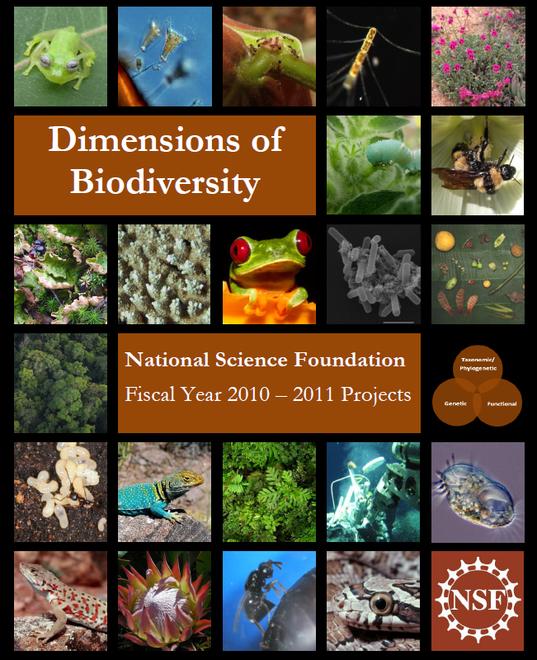
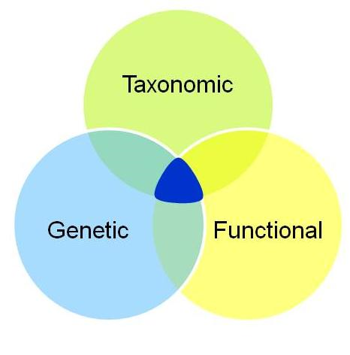
Dimensions of Biodiversity
[BIO, GEO, OISE, OPP, Brazil, China]
A multi year effort to characterize the dimensions of biodiversity at the intersections of three areas
Target
5 Grand Challenges
Notes:
The goal of the Dimensions of Biodiversity campaign is to transform, by 2020, how we describe and understand the scope and role of life on Earth. The campaign promotes novel, integrated approaches to identify and understand the evolutionary and ecological significance of biodiversity amidst the changing environment of the present day and in the geologic past. It requires addressing multiple dimensions of biodiversity, i.e. genetic, taxonomic, and functional ,simultaneously and in novel ways, to understand their synergistic roles in critical ecological and evolutionary processes.
Campaign started 2010
2010: 13 awards for $23.7M
1 US-China joint I-RCN
2011: 11 awards for $19M

Slide 9
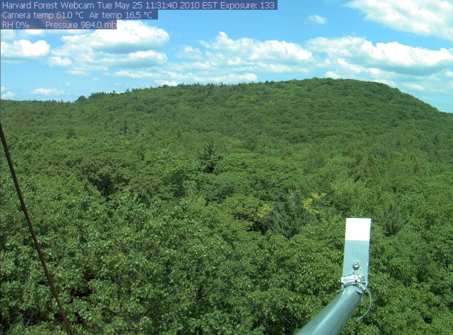
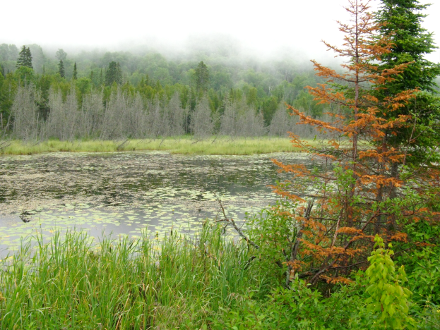
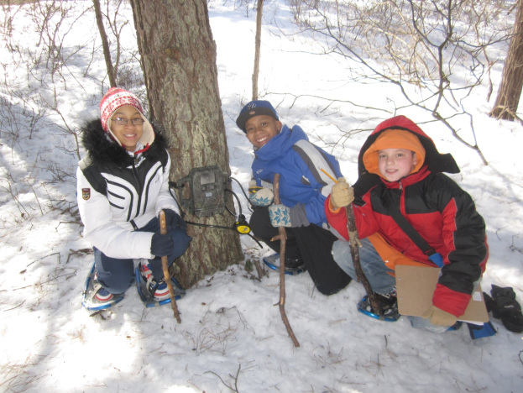
MacroSystems Biology
Research on Biological Systems at Regional to Continental Scales will support quantitative, interdisciplinary, systems-oriented research on biosphere processes and their complex interactions with climate, land use, and invasive species at regional to continental scales as well as planning, training, and development activities to enable groups to conduct MacroSystems Biology Research.
21 Active Awards averages $2.2 M April each year

Slide 10
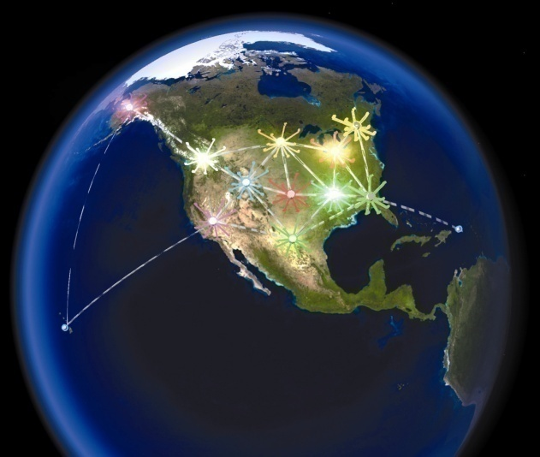
Earth, Climate, and Biosphere
BIO-funded Cyber-Enabled Observatories, Synthesis Centers, and Long Term Ecological Programs increase understanding of life’s responses to environmental change and inform sustainable solutions
The National Socio-Environmental Synthesis Center (BIO and SBE)
Long-term Ecological Research Program (BIO, GEO, OPP, SBE)
National Ecological Observatory Network
5 Grand Challenges
Notes:
The Long Term Ecological Research (LTER) Network is a collaborative effort involving more than 1800 scientists and students investigating ecological processes over long temporal and broad spatial scales The Network promotes synthesis and comparative research across sites and ecosystems and among other related national and international research programs. The NSF established the LTER program in 1980 to support research on long-term ecological phenomena in the United States. The 26 LTER Sites represent diverse ecosystems and research emphases.
The Dynamics of Coupled Natural and Human Systems (CNH) Program promotes interdisciplinary analyses of relevant human and natural system processes and complex interactions among human and natural systems at diverse scales.
Synthesis research combines data, models, and ideas from multiple scientific disciplines to address challenges facing coupled human- natural systems. Programs focus on critical challenges such as water availability, sustainable food production, and the interaction between human activity and healthy ecosystems.
SESYNC programs support the synthesis of natural and social science in addressing problems of the environment. Fostering fundamental, discovery-driven synthesis research that contributes to actionable science is central to the center's mission. SESYNC stresses the importance of identifying research priorities through dialogues with policy-makers and other audiences outside the science community. As a national synthesis center, SESYNC's facilities, computational and technical services, and programs are designed to serve the broad socio-environmental scholarly community.

Slide 11
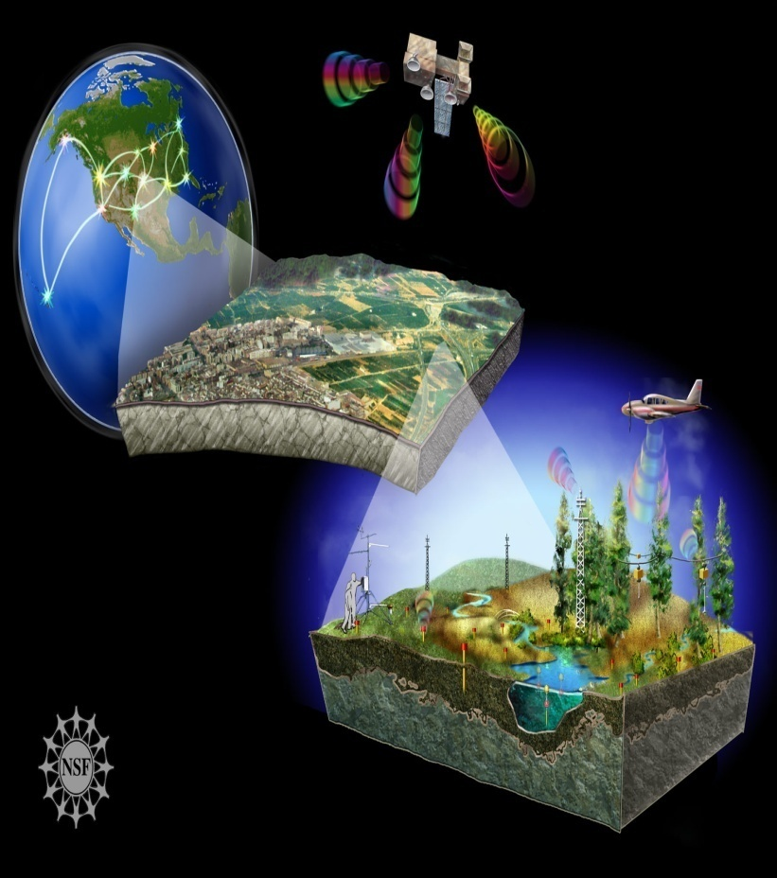
National Ecological Observatory Network
A unique infrastructure platform to address fundamental regional to continental scale environmental research questions
Research platform for all BIO, from molecules to the biosphere
Long-term measurements with standardized infrastructure, procedures, quality control
Persistent and Flexible
Remote Sensing (Scaling)
Free and open data access policy for near real time data
Education Innovation
Experiments at continental scale (STREON)
Notes:
NEON is a continental scale research platform for understanding and forecasting the impacts of climate change, land use change, and invasive species on ecological processes and on interactions of the biosphere with the geosphere, hydrosphere , and atmosphere. In consultations with experts, measurements were carefully selected to represent the causes and effects of environmental change. NEON manipulative experiments are designed so that forecast models can be developed that accurately anticipate future conditions. The collection of carefully selected suites of related variables at strategically selected locations across 20 eco-climatic domains in the U.S. constitutes a single virtual instrument that continuously takes the pulse of the nation’s ecosystems over the lifetime of the laboratory.

Slide 12
National Ecological Observatory Network (NEON)
MREFC $91M Construction funding will support:
Civil and facility construction of 15 sites in 6 domains;
Stream Experimental and Observatory Network (STREON) construction will begin
R&RA $30M for Management and Operations; $3M for Concept & Development :
7 sites in 5 Domains
Airborne Observatory &Calibration and Validation Laboratory
Data Center

Slide 13
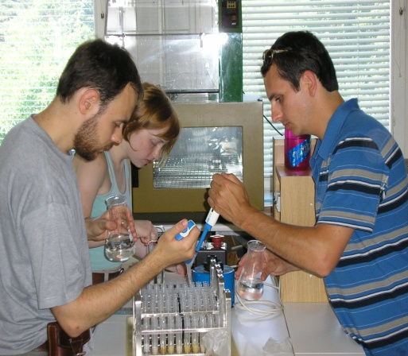
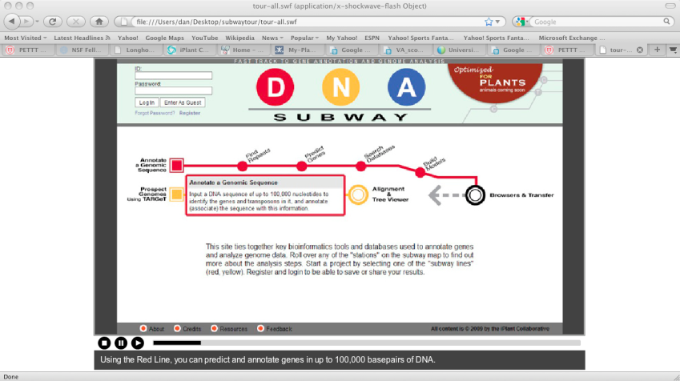
STEM Education
Transforming Undergraduate Biology Education (TUBE)
Expeditions in Education (E²)
- New Age Cyber Learning
iPlant - DNA Subway

Slide 14
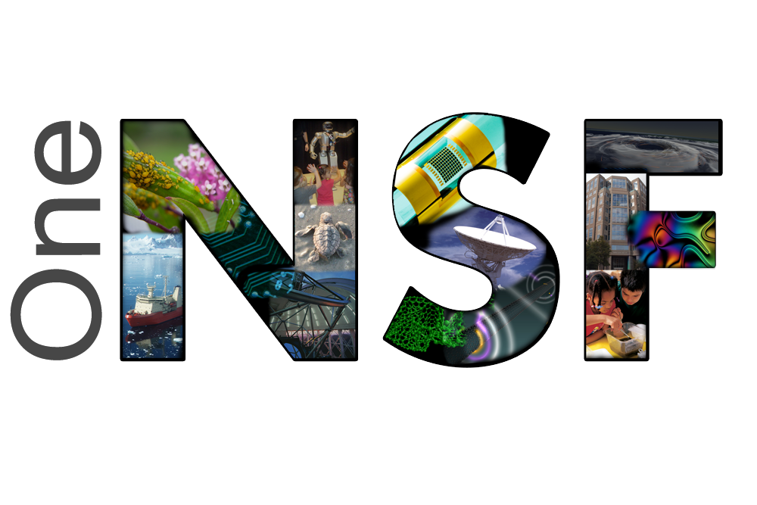
SEES - Science, Engineering, and Education for Sustainability
BioMaPS - Intersections of Biological, Mathematical and Physical Sciences
CIF21 - Cyberinfrastructure Framework for 21st Century Science and Engineering
CEMMSS – Cyber-Enabled Materials & Manufacturing & Smart Systems
I-Corps - Innovation Corps
INSPIRE - Integrated NSF Support Promoting Interdisciplinary Research and Education

Slide 15
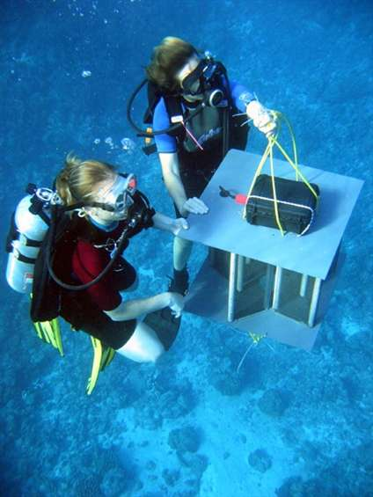
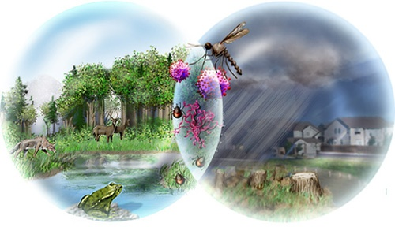
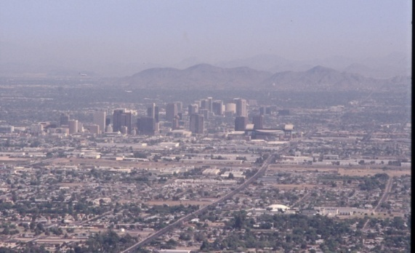
Science, Engineering, and Education for Sustainability (SEES)
-
Interdisciplinary research to understand human systems, biological systems, and educate the next generation of scientists.
BIO contributions to SEES:
Core research programs in all four divisions
Coupled Natural and Human Systems
Dimensions of Biodiversity
Ocean Acidification
Sustainability Research Networks
SEES Research Coordination Networks ($12M)
SEES FellowS
Credit: NSF Moorea Coral Reef LTER Site
FY 2013 Request: BIO $34.75M
Notes:
Science, Engineering, and Education for Sustainability (SEES) is a portfolio of activities that highlights NSF's unique role in helping society address the challenge(s) of achieving sustainability. SEES projects are NSF wide initiatives that provide foundational knowledge about the environment, and economic effects of anticipated changes in sea level, and chemistry i.e. ocean acidification, rainfall, growing seasons, bio-diversity, and essential ecosystem services, and for the development of responsive adaptation and mitigation strategies. By supporting interdisciplinary research and education, SEES will develop the workforce needed to understand and address complex issues of environmental sustainability

Slide 16
BIO Big Data Issues
Biological data is rapidly growing in amount and complexity resulting in challenges of data storage, interoperability, curation, maintenance & access
One data solution or many (e.g., Genbank, Protein Data Bank, Digital Data Repository)
What data are saved and for how long – legacy data and new data? (e.g. iPlant, LTER, NEON)
Common standards for adding/annotating data to ensure broad access and interoperability?
How will access to data be provided?
How and where will data be stored?
Who pays? Who is in charge?

Slide 17
BIO Cyber Activities
CIF21 - Cyberinfrastructure Framework for 21st Century Science and Engineering
- SI² - Software Infrastructure for Sustained Innovation
ADBC- Advancing Digitization of Biological Collections
iPlant Collaborative
DRYAD - Digital Data Repository
NIMBIOS - National Institute for Mathematical and Biological Synthesis
NEON - National Ecological Observatory Network
Notes:
1) ADBC: Enhance and expand the national resource of digital data; document existing vouchered biological and paleontological collections. Improve access to digitized information (including images) residing in vouchered scientific collections across the United States. Structured at three levels:
Central coordinating organization: National Resource for Digitization of Biological Collections: Integrated Digitized Bio-collections at Univ. of Florida (iDigBio)
Series of thematic networks based on an important research theme
The physical collections
2) Cyber Infrastructure: The Software Infrastructure for Sustained Innovation (SI²) program includes Conceptualization Awards - planning awards to organize an interdisciplinary community to determine its software requirements and challenges. BIO is especially interested in conceptualization proposals that focus on high priority research problems and that will significantly leverage existing investments in ways that will transform infrastructure that supports BIO and related research.
3) iPlant Collaborative: national cyber-infrastructure center to address global plant biology questions that have implications for agriculture, energy, natural resources and the environment
ATOL: Phylogenetic systematics has advanced our understanding of the evolutionary relationships of groups of organisms across the tree of life from the simplest microbes to plants and primates. Rapid progress in recent years has been due to advances in technology, methods, and theory generated by NSF funded projects from the Assembling the Tree of Life Program and Systematics and Biodiversity Science cluster in the Directorate for Biological Sciences. Phylogenetic systematics provides a powerful tool for understanding the evolution of genes and assessing potential risks and benefits of organisms (like strains of disease-causing bacteria or medicinally useful compounds). And, “tree-thinking” (examining patterns of relatedness) has become the basis for investigation of new questions in genomics, ecology, behavior, and development.

Slide 18
Funding of Research for EREN and other Research Observatories and Networks
Programs:
Core Programs across BIO and NSF
Macrosystems Biology
Research Coordination Networks
SEES related Programs
Cyber - OCI – CIF21 and Big Data
Innovation – Workshops or Rapid/Eager, INSPIRE
Advanced R&D - MRI or unsolicited
Synthesis/Policy - BIO Centers
Notes:
NEON is a continental scale research platform for understanding and forecasting the impacts of climate change, land use change, and invasive species on ecological processes and on interactions of the biosphere with the geosphere, hydrosphere , and atmosphere. In consultations with experts, measurements were carefully selected to represent the causes and effects of environmental change. NEON manipulative experiments are designed so that forecast models can be developed that accurately anticipate future conditions. The collection of carefully selected suites of related variables at strategically selected locations across 20 eco-climatic domains in the U.S. constitutes a single virtual instrument that continuously takes the pulse of the nation’s ecosystems over the lifetime of the laboratory.

Slide 19
Thank you.
Questions?

Slide 20
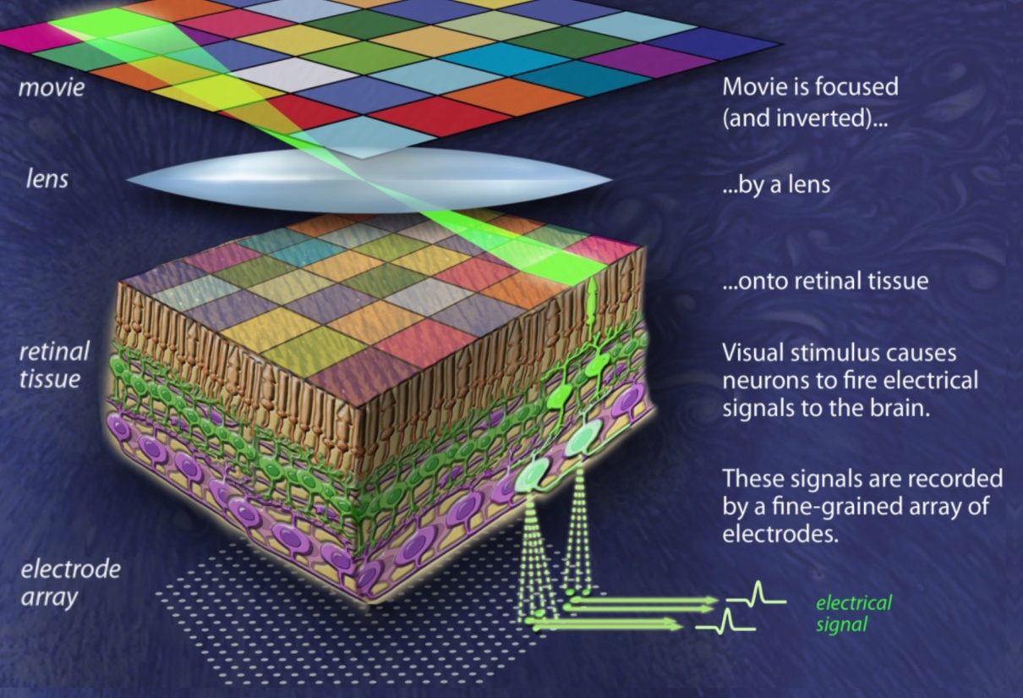
Biological, Mathematical & Physical Sciences and Engineering (BioMaPS)
Goal: Discover fundamental new knowledge at the intersections of the biological, mathematical and physical sciences and engineering
FY 2013 priorities:
Accelerate understanding of biological systems to enable innovation in clean energy, climate science, and advanced manufacturing
Attract future scientists and engineers

Slide 21
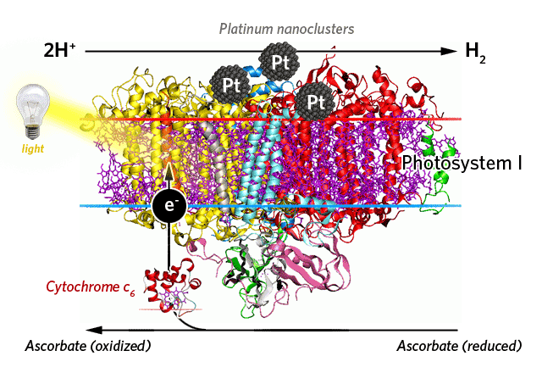
Natural energy transduction systems can inspire biology-based technologies capable of delivering sustainable clean energy.
CLEAN ENERGY
Platinum -Photosystem I nanoparticle that produces hydrogen fuel
Barry Bruce, Univ. TN Knoxville
Notes:
Programs in BIO support cutting edge molecular and nanoscale research in natural energy transduction systems such as harvesting photosynthetic organisms like rhodobacter spaeroides; and studying Proteorhodopsins, which are photoactive retinylidene proteins in some marine bacterioplanktons and eukaryotes, and functions as a light driven-proton pump. Current projects include re-engineering microbes to produce hydrocarbons and developing photovoltaic bio-energy cells that are modeled on photosynthetic systems to produce clean energy.
A project at the University of Tennessee has demonstrated that hydrogen evolution by a biomolecular-metal composite of Photosystem I and platinum could potentially exceed the current best biomass-to-energy system, which is switchgrass-produced ethanol, by 25-fold. This research is the basis for development of a highly engineered, kinetically enhanced, spectrally extended, photosynthetic hydrogen-evolving nanoparticle.
The goal of another project at Arizona State University is to create novel bio-films capable of increased solar energy capture and storage by photosynthesis for diversion to more efficient processes. Insights gained from these projects are seminal for the construction of synthetic and semi-synthetic molecular energy converters, which may have profound implications in an energy-demanding world.

Slide 22
BIO Participation in Major Investments
BIO Investments
(Dollars in Millions)
Area of Investment | FY 2012 Current Plan | FY 2013 Request
Advanced Manufacturing | $2.00 | $2.60
BioMaPS | 9.00 | 13.57
CAREER | 31.13 | 32.63
CEMMSS | 3.00 | 5.00
CIF21 | 2.00 | 4.00
Clean Energy Technology | 39.00 | 45.00
E² | - | 2.00
I-Corps | 0.50 | 2.00
INSPIRE | 2.00 | 4.00
SEES | 27.25 | 34.75
BIO 5 Grand Challenges | - | 20.00
Major investments may have funding overlap and thus should not be summed.

Slide 23
Five Grand Challenges
[From 2009 National Research Council Report]
All BIO Core Programs
+ $20 million
Synthesizing Life-Like Systems
Genomes to Phenomes
The Brain: NeuroSystems
Earth, Climate, and Biosphere
Biological Diversity
NRC:2010

Slide 24
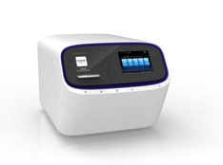
Managing Data
Biological data is rapidly growing in amount and complexity resulting in challenges of data storage, interoperability, curation, maintenance & access
Milestone: $1000 human genome in a day
Ion Proton Sequencer
Life Technologies
Implications for future of BIO at all levels, national
and international, education and application.
Notes:
Software Infrastructure for Sustained Innovation program’s Conceptualization Awards organize an interdisciplinary community to determine software requirements and challenges
The Life Technologies Ion Proton Sequencer, priced at $149,000 will sequence an entire human genome with 20 to 30X coverage in a day for just $1,000
The $1,000 genome has long been a milestone in genomics—the estimated price when individualized genome sequencing would be practical for doctors to use with patients. “It’s a tremendous race to the bottom,” with the cost of sequencing dropping 33 percent per quarter since 2007, said Quackenbush. Sequencing is becoming so cheap, added Weinstein, that its cost could soon be the least of genomics research expenses, which include the cost of acquiring samples, preparing them, and post-sequencing bioinformatics.
In basic research, same day genomes will shorten the time from experiment to results, said Weinstein. In medicine, the technology could inform time-sensitive events, such as choosing a therapy for a cancer patient or identifying and combating an infectious disease.

Slide 25
Science, Engineering, and Education for Sustainability (SEES)
Goal: Generate discoveries and build capacity to achieve an environmentally and economically sustainable future
FY 2012 priorities:
Advance a clean energy future
Nurture the emerging SEES workforce
Expand research, education, and knowledge dissemination
Engage with global partners
NSF-wide effort addresses complex problems at the energy, economy, and environment nexus
FY 2013 Request: Total: $M; BIO $34.75M

Slide 26
INSPIRE Awards
CREATIV—Second year of the CREATIV pilot grant awards
Open to all NSF-supported fields
Typically for an individual PI or a small team
Proposals must be interdisciplinary and potentially transformative
Internally merit-reviewed by program directors with option for external expert review where needed
Maximum award: $1.0 million (not limited to exploratory stage)
Maximum award duration: 5 years
New open pilot mechanism under INSPIRE to begin in FY 2013
Larger “mid-scale” interdisciplinary awards up to $2.5-$3.0M
Utilize novel internal & external merit review approaches

