Slide 1
Decomposition in aquatic and terrestrial invaded systems (DATIS): scientific and educational insights from collaboration within the Ecological Research as Education Network
Tracy B. Gartner, Carthage College
Carolyn L. Thomas, Ferrum College
and
The Ecological Research as Education Network

Slide 2
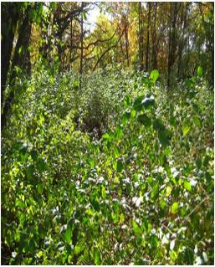
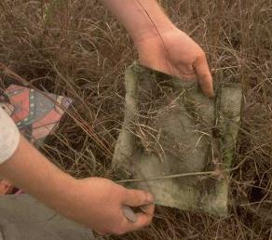
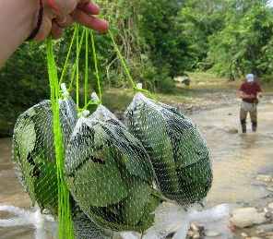
Scientific Background
Woody invasive species influence many ecosystem functions
[N] and decay rates often higher (Ehrenfeld 2010)
Impacts may vary with species and relative abundance
Methods vary between terrestrial and aquatic decomposition experiments

Slide 3
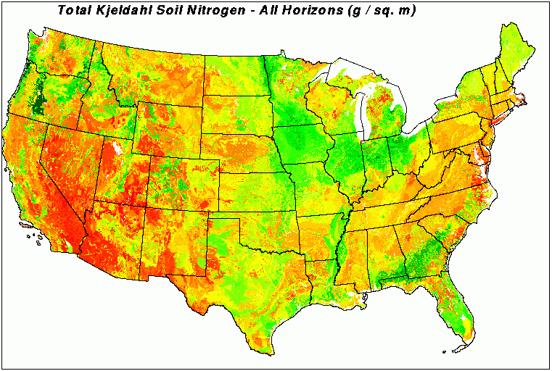
Using the EREN Model
Decomposition rates influenced by litter quality and site factors, which can vary with region
U.S. Soil Nitrogen Concentrations
from
Hargrove and Luxmoore, 1998
EREN schools provide natural gradients and a mix of aquatic and terrestrial expertise

Slide 4
Questions
Are decomposition rates of invasive species faster than native species across a wide range of environments?
Does increasing relative abundance of the invasive have a linear impact on decomposition rates?
Can integrative protocols for aquatic and terrestrial decomposition studies be conducted successfully as part of an undergraduate curriculum?

Slide 5
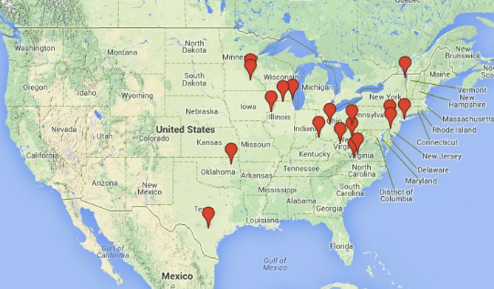
Participants
Kevin Geedey - Augustana College, IL
Rick Boyce – Northern Kentucky University, KY
Jerald Dosch, Dan Hornbach – Macalester College, MN
Kathy Shea – St. Olaf College, MN
Fernando Nieto – SUNY College at Old Westbury, NY
Rachel Schultz - SUNY Plattsburgh, NY
Laurie Anderson – Ohio Wesleyan University, OH
Craig Zimmerman – Rogers State University, OK
Frank Kuserk – Moravian College, PA
Jose-Luis Machado – Swarthmore College, PA
Jamie March – Washington and Jefferson College, PA
Kelly Lyons – Trinity University, TX
Greg Eaton – Claytor Nature Study Center, Lynchburg College, VA
Carolyn Thomas, Bob Pohlad - Ferrum College, VA
Tracy Gartner - Carthage College, WI
Carol Mankiewicz – Beloit College, WI
Kim Bjorgo-Thorne – West Virginia University, WV
Kevin Barry – West Virginia State University, WV
10 sites in 2012-13
18 sites in 2013-14

Slide 6
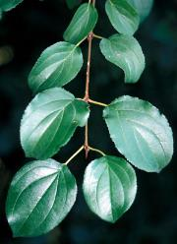
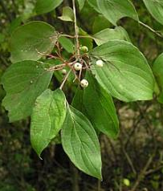
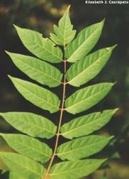
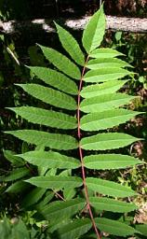
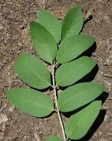
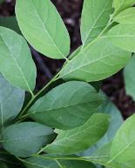
Litterbag Experiment
Leaves collected from locally relevant woody invasive and a morphologically & functionally similar native species
Invasive | Ex. Native Pairing
Buckthorn | Black Cherry, Gray Dogwood
Honeysuckle | Spice Bush
Privet | Texas Mountain Laurel
Tree of Heaven | Smooth Sumac
Norway Maple | Sugar Maple, Red Maple
Buckthorn
Dogwood
Tree of Heaven
Sumac
Honeysuckle
Spicebush

Slide 7
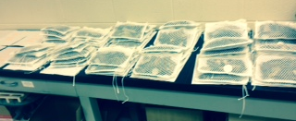
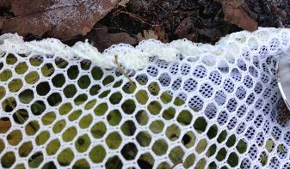
Litterbag Construction
Litterbags filled with varying ratios of two litter types
(5 treatments x 5 reps/harvest)
Native
20 cm² custom nylon bags
Bottom: 1/16” mesh
Top: 1/4” mesh
Invasive
T1
T2
T3
T4
T5

Slide 8
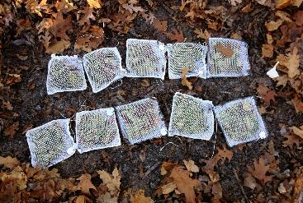
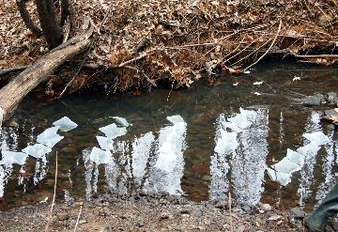
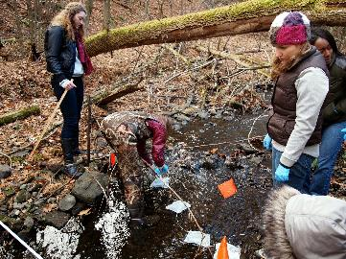
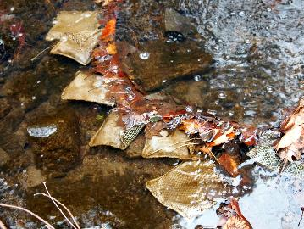
Deployment

Slide 9
2012-2013
Aquatic Environment
Invasive decomposition not always slower
May be species specific (Ailanthus vs. Rhamnus)
Terrestrial Environment
Faster decay by Rhamnus
Ailanthus decay variable

Slide 10
2013-2014 Results
Aquatic Decay
Terrestrial Decay
?
?

Slide 11
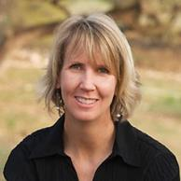
Assessment
"The consistent interplay between curiosity and understanding in both teaching and research is what motivates me. And when I can inspire my students to be motivated by their curiosity to understand, I feel I have succeeded!"
- Kelly Lyons, Ph.D.
DATIS Project Used in a Variety of Formats:
Introductory to Upper Level Courses, Majors and Nonmajors
Biology, Environmental Science, Sub-disciplines
Independent Research or Thesis Projects
Work-study students

Slide 12
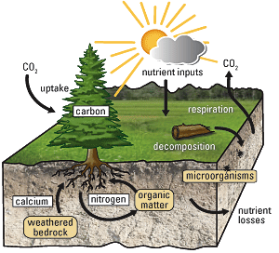
Universal Learning Goals
Students should be able to:
Describe the role of plant decomposition in nutrient cycling in ecosystems
Identify the physical and biotic factors that influence the rate of plant decomposition and explain how these factors interact at different geographic or temporal scales
Explain the impact of human influences on plant decomposition
Photo Source: USGS

Slide 13
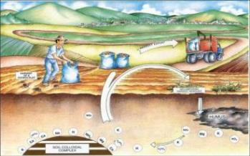
Assessment: Pre-Post Tests (aim to implement 2014-15)
Where does the mass of the leaves go following decomposition? (LO1: role)
What is responsible for the decomposition of the plant leaves? (LO2: process)
Describe some ways that humans might influence these processes now and in the future (LO3: human impacts)
Photo Source: Sustainable Sanitation &Water Management

Slide 14
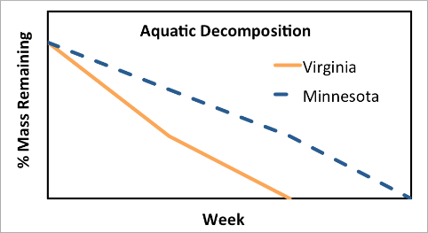
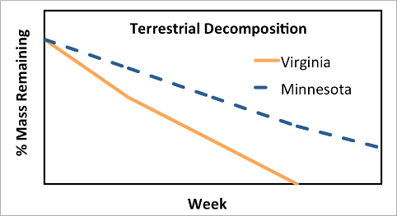
Assessment: Pre-Post Tests (aim to implement 2014-15)
Interpret what is represented in the figures (LO2: importance of geography and time)

Slide 15
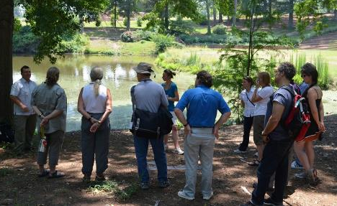
Professional Development
Workshops for methodology
Constructing litterbags
Litterbag placement
Data analysis
Protocol refinement
Collaborative process
Curricular support
Informal peer-to-peer mentoring

Slide 16
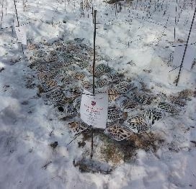
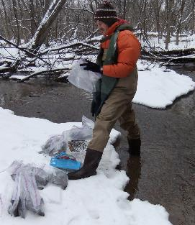
Challenges
Timing of project
Climate and weather
Snow and Ice
Variability in sites = variable timing
Academic schedule
Variable timing of senescence
Full year vs. semester schedules
Labor intensive
Space restrictions
Data Consistency
Sedimentation - “The terrestrial is easier”
Small changes in mass are important

Slide 17
Strengths
SCIENTIFIC CONTRIBUTION
Important contribution to decomposition and invasion knowledge
Regional variability
EDUCATIONAL
Students engaged in entire process of research – quantitative reasoning and critical thinking
Decomposition can be used to address many concepts in ecology
Integration of multiple years results in peer learning and training
Sense of ownership and student engagement
COLLABORATIVE NATURE
Combination of aquatic and terrestrial unites the silos
Collaboration merges student/faculty expertise among colleges
Collaborators

Slide 18
Decomposition in aquatic and terrestrial invaded systems (DATIS): scientific and educational insights from collaboration within the Ecological Research as Education Network
Tracy B. Gartner, Carthage College, tgartner@carthage.edu
Carolyn L. Thomas, Ferrum College, cthomas@ferrum.edu
and
The Ecological Research as Education Network
www.erenweb/datis

