Slide 1
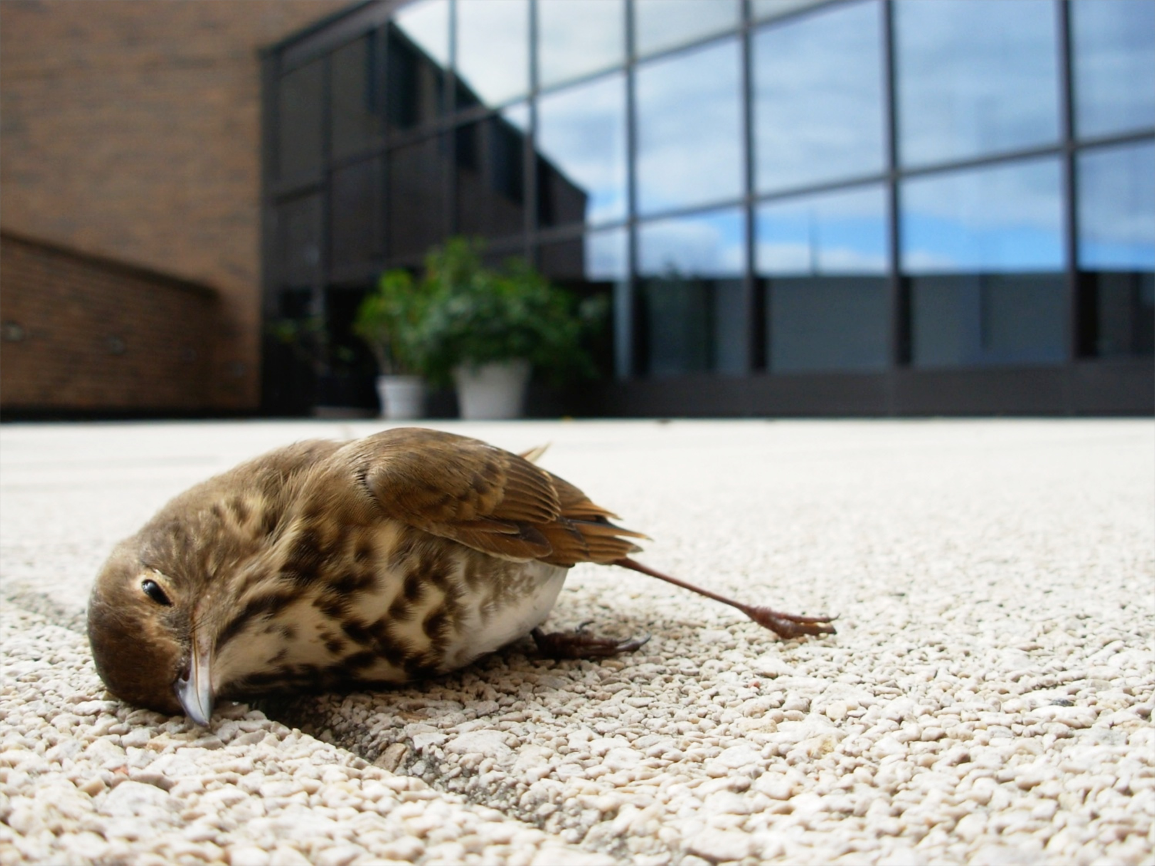
Evaluating the drivers of bird-window collisions throughout North America
Stephen B. Hager,
Bradley J. Cosentino,
and others

Slide 2
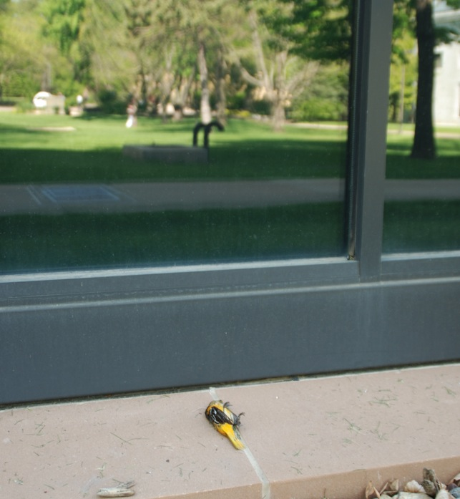
Outline:
Background of BWCs
Rationale and goals for broad-scale collaboration
Methods
Results from the fall 2013 pilot season results
2014 Update

Slide 3
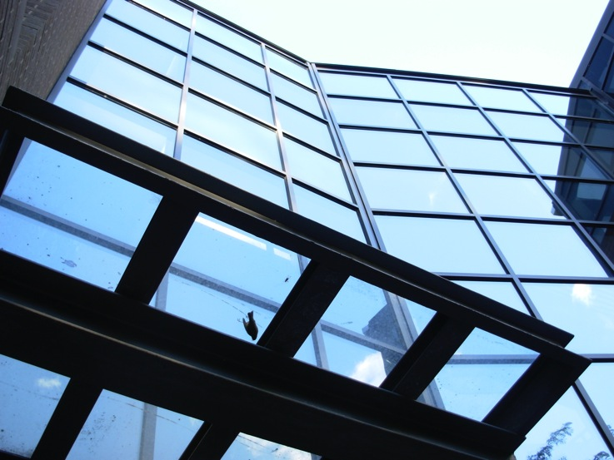
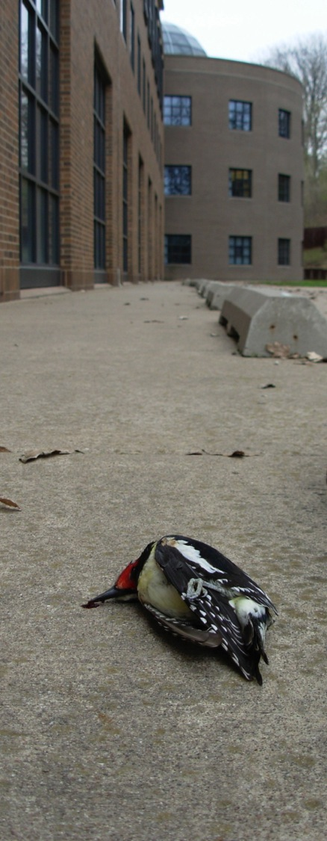
Background
Lethal windows: any kind of sheet glass that reflects environmental features
400 million to 1 billion birds may die in the United States
Importance? Urbanization / Bird ecology

Slide 4
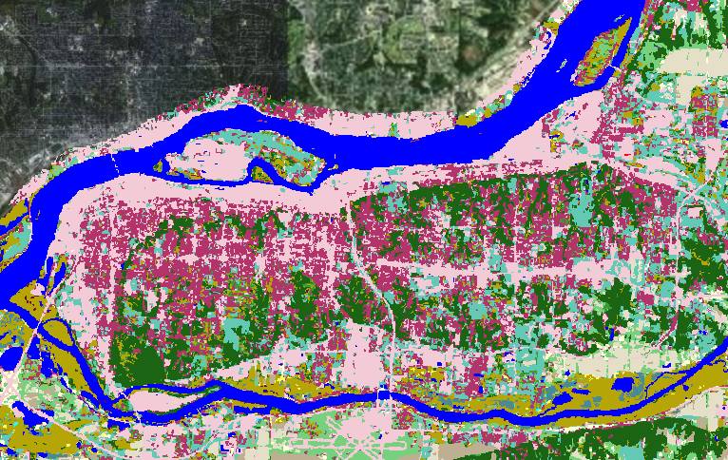
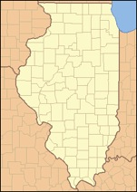

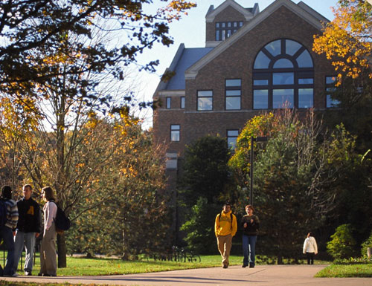
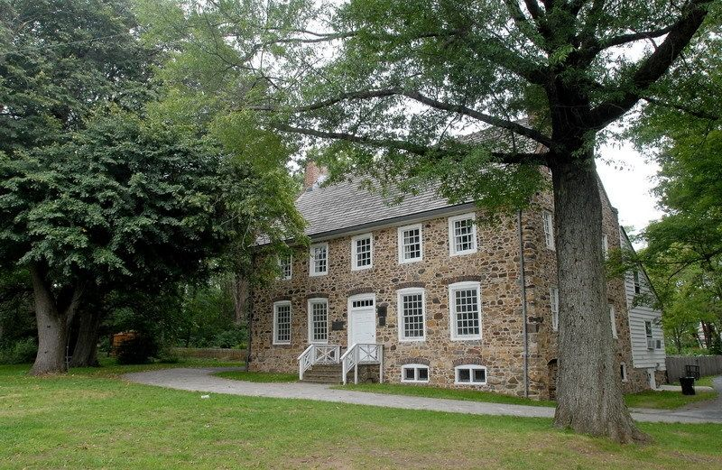
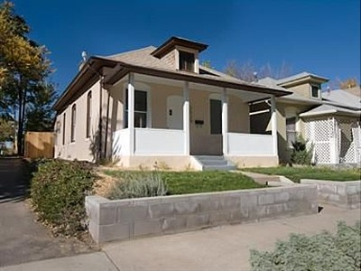
Background, cont’d
Evaluation of the drivers of BWCs at 20 buildings in for a year 2010
Stratified bldg selection: building size and four categories of land cover
Hypothesized factors:
Window area
Local development
Distance to forest patches
Bird feeders
◉
High mortality
Moderate mortality
No mortality
High mortality
Moderate mortality
No mortality
Notes:
Environmental resources have been hypothesized to be a primary driver of BWCs. Quality vegetation and artificial feeding stations increase bird density by providing food and shelter, and the number of fatalities is predicted to be proportional to species abundance.
BWCs are also hypothesized to be influenced by the amount of sheet glass in buildings and mortalities should correlated positively with window area. Large buildings in the city’s core commercial district is composed of many large buildings with displaying high window area and collisions should be high. Currently, ~20% of the total building area of commercial space in the United States may be found in suburban and exurban areas.
It remains equivocal that these hypotheses explain BWCs across the urban matrix because most research has been restricted by low replication of buildings, buildings with known mortalities, and failing to account for the factors that affect imperfect detection of carcasses.

Slide 5
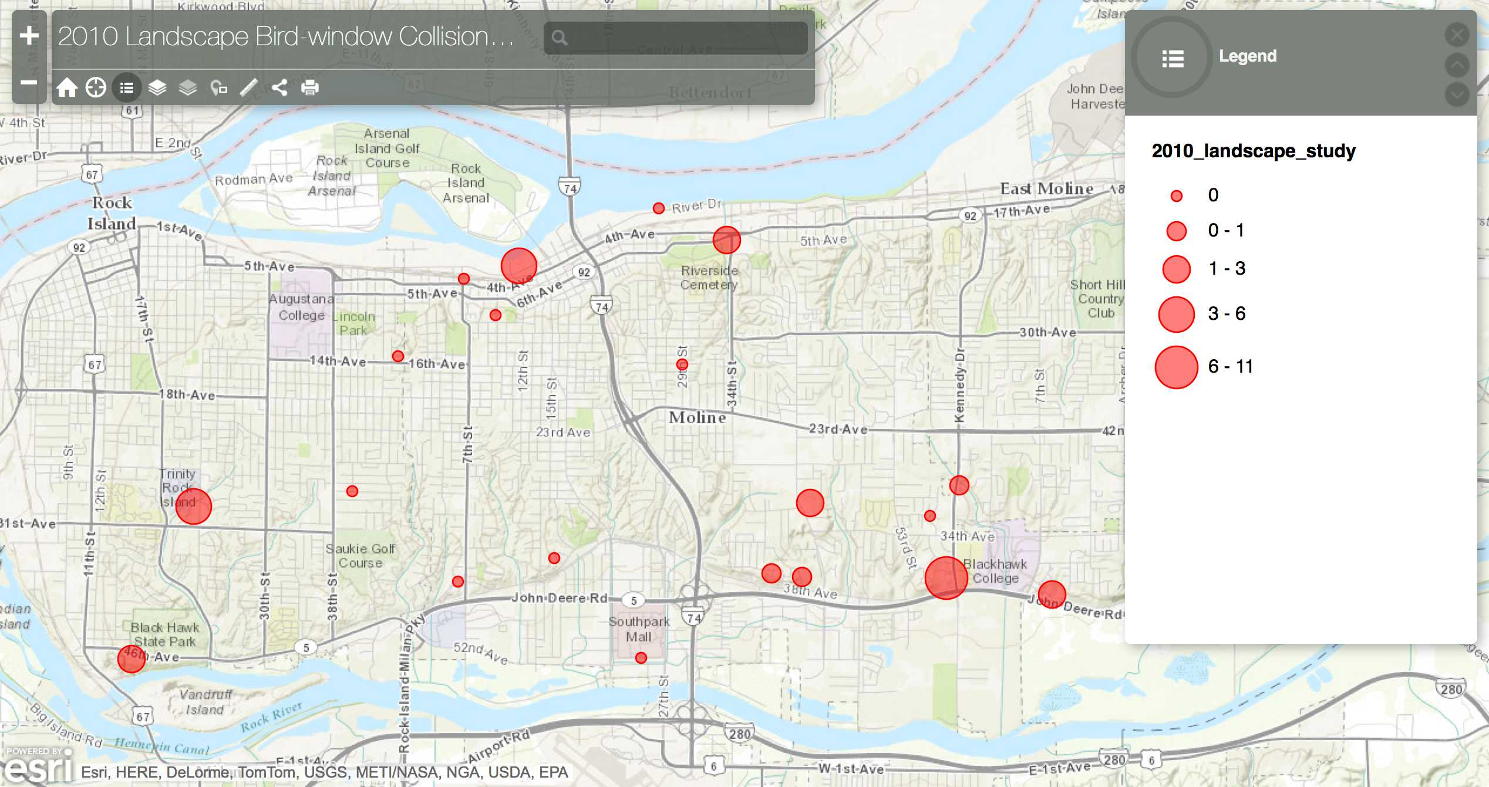
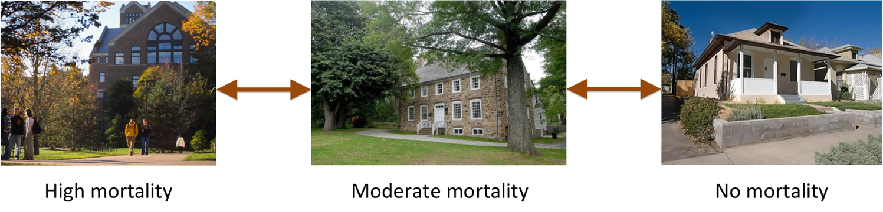
Magnitude of mortality (N = 34 carcasses)
Window area and development drive BWCs
High mortality
Moderate mortality
No mortality
High mortality
Moderate mortality
No mortality

Slide 6
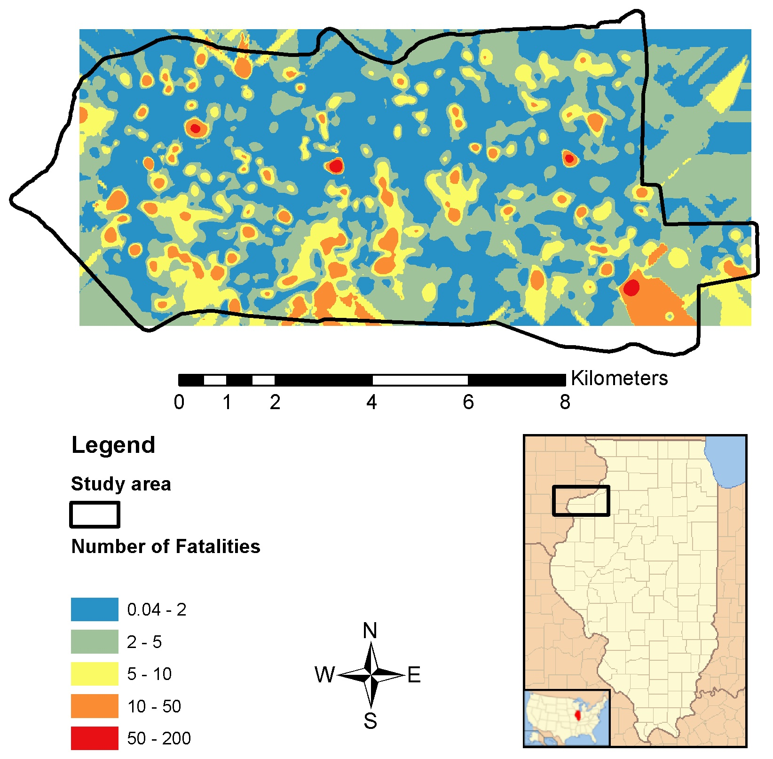
Why is it important to know the drivers of BWCs?
Model bird mortality
Land use management
◉
High mortality
Moderate mortality
No mortality
High mortality
Moderate mortality
No mortality
Notes:
Wildlife managers could mitigate collisions at hot spots by installing anti-collision windows
This can be used by land planners to make decisions of development with birds in mind
It remains equivocal that these hypotheses explain BWCs across the urban matrix because most research has been restricted by low replication of buildings, buildings with known mortalities, and failing to account for the factors that affect imperfect detection of carcasses.

Slide 7
?
?
?
?
?
?
?
?
Notes:
However, the factors driving this variation within and among landscapes remain unexplored.
Indeed, cities throughout NA are locally unique and diverse configurations of urban development. Anchorage is different than Mexico City, which is different than Miami, which is different than St. John’s Newfoundland.
At broad scales, the types of birds may also be unique by virtue of what is present based on species ranges and how those local species are affected by development

Slide 8
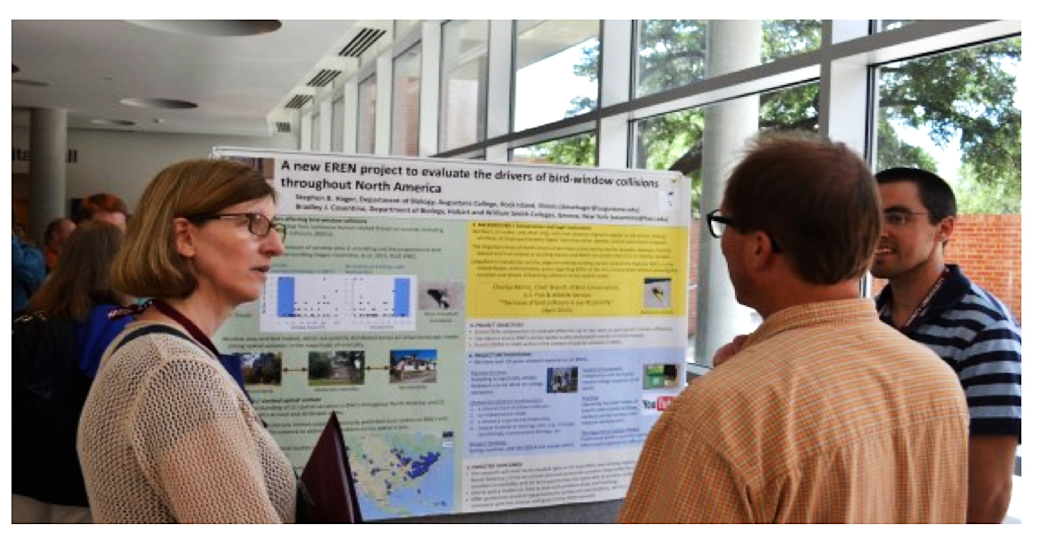

Slide 9
Complete a pilot field season in fall 2013 to:
Develop standardized sampling protocols to evaluate the drivers of BWCs
Test project protocols
Conduct a preliminary analysis of the data collected
Recruit for fall 2014

Slide 10
Sampling Protocols

Slide 11
Selecting Buildings
Surveys for bird carcasses: how
22 Sept
Surveys for bird carcasses: when
12 Oct

Slide 12

Measuring windows, categorized tinting, # stories, and floorspace

Slide 13
Estimate local development in a GIS: proportion of vegetation and impervious surfaces

Slide 14
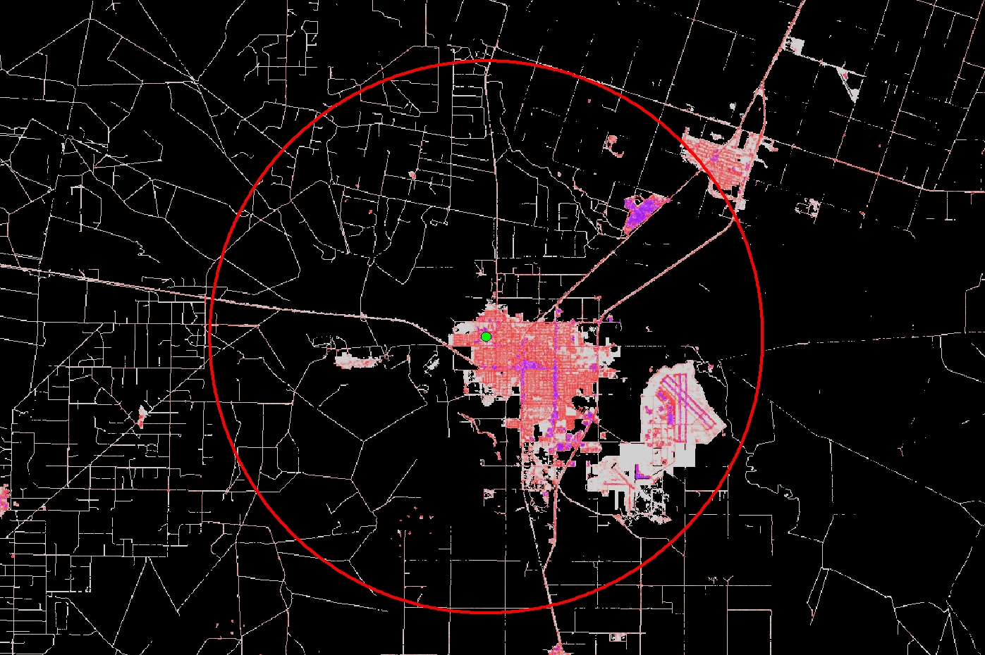
Estimate regional development (proportion)
Texas A & M, Kingsville

Slide 15
Data Analysis
21 daily carcass surveys at 87 buildings across the 13 sites
Generalized linear mixed models assessed:
Total window area for each building**
Window tinting (clear, tinted, or tinted-reflective)
Local digitized vegetation cover within 50 m
Proportion of developed land within 10 km buffer
# Bird
Carcasses
**Floorspace and stories

Slide 16
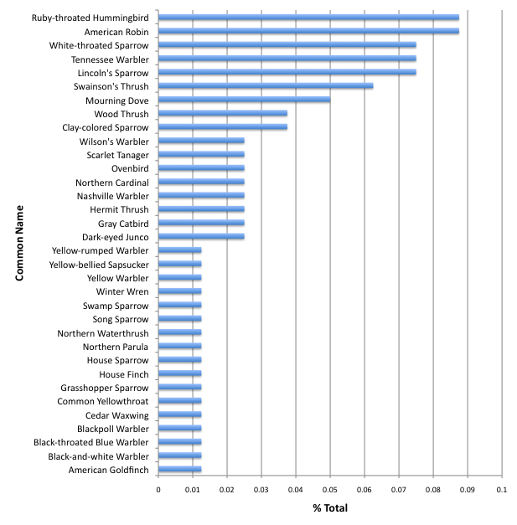
Results
91 bird carcasses
39 species

Slide 17
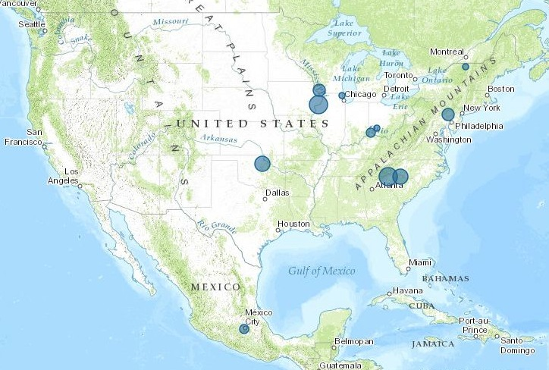
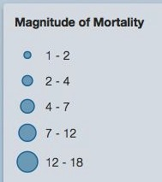
Results

Slide 18
Results
window area for each building
local digitized vegetation cover within 50 m
proportion of developed land within 10 km buffer
# Bird
Carcasses
window tinting (clear, tinted, or tinted-reflective)
# Carcasses

Slide 19
Sampling Protocols Performed Well

Slide 20
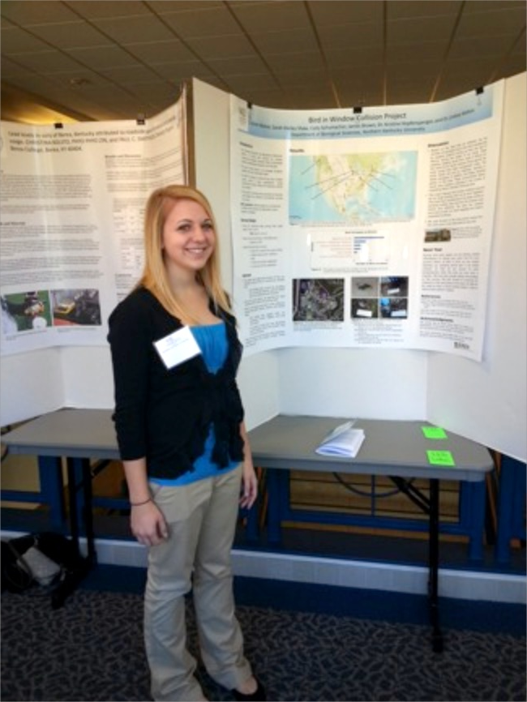
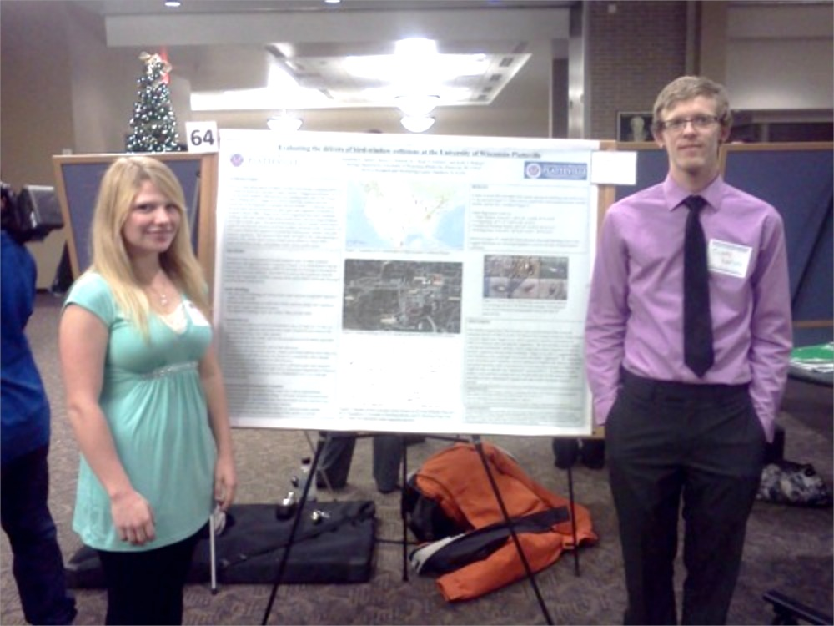
Results
189 undergraduate students and 21 faculty/professional researchers

Slide 21
2010 = 1 site

Slide 22
2013 = 13 sites
Notes:
However, the factors driving this variation within and among landscapes remain unexplored.
Indeed, cities throughout NA are locally unique and diverse configurations of urban development. Anchorage is different than Mexico City, which is different than Miami, which is different than St. John’s Newfoundland.
At broad scales, the types of birds may also be unique by virtue of what is present based on species ranges and how those local species are affected by development

Slide 23
2014 = ~50 sites

Slide 24
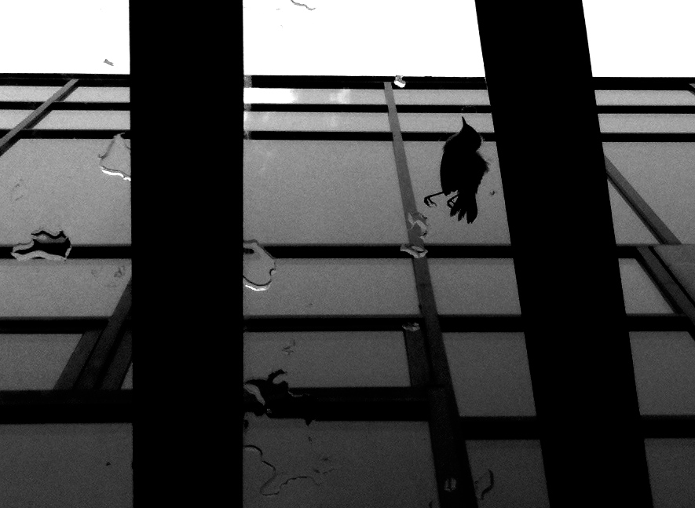


Acknowledgements

